Slide 1
Secret Key Sharing Based on the Use of ESPAR With Multipath Channel Model.
V.Korzhik, V.Yakovlev, Y.Kovajkin, D.Ovechkin
(University of Telecommunications, St.Petersburg, Russia; E-mail: val-korzhik@yandex.ru)
Singapor NTU, 2010

Slide 2
1. Introduction The main ways of key sharing: a) Transmission the keys over secure (encrypted) channels or a delivering them by special messengers; b) Using public key concept; c) Key sharing based on a presence of any noisy channel if adversary is passive, (wire-tap channel type I and II) [1,2,3] d) Key sharing based on a presence of active adversary if its channel is less noisy than channel of legal users. [4,5] e) Key sharing using quantum channels.[6] f) Key sharing based on a concept of anonymous channel. g) Key sharing based on a concept of broadcasting channel. h) Key sharing based on ESPAR-like radiator over multipath channels. [7,8]

Slide 3
Because method a) is trivial and b) is well known, we consider briefly methods c) ÷ g) and method h) in more details as a subject of our presentation.
c) Source model with a passive eavesdropping .
Aplication Key distribution via a satellite.
Fact ( Maurer [3] )

Slide 4
Privacy amplification ( Bennett , Brassard , Crepeau , Maurer [9,10])
The feature of keyless cryptography is :
( i ) Share the secret key by legal parties using this concept
( ii ) Use key - cryptography after receiving this key by legal parties
(including perfect cipher)
To share secret key , A and B perform the following steps
1.A sends to B a truly random string x over public noisy channel .
2.A sends to B the check symbols to x chosen in line with some error correcting code V
3.A sends to B a truly random hash function h taken from universal² class , which maps
a string x of length n to string K of length k .
4.B corrects errors in the string x using check symbols transmitted by A .
5.Both A and B produce the key string as K = h ( x ) .
Then the amount of information leaking over the wire - tap channel to eavesdropper
E has the following upper bound [9,11]
where n is the length of x , k - is the length of the key K , r - is the number of check symbols , t - is the amount of collision ( Renyi ) information leaking over the wire - tap channel to eavesdropper E .
for BSC - wire - tap channel with BER=

Slide 5
Wire - tap channel type 2 . (Wyner [2])
An eavesdropper can observe a subset of his ( her ) choice of size t < n , where n is the block length
Main applications - quantum cryptography (see in the sequel ) , optical fiber multiplexing , computer network containing eavesdroppers in some nodes
Regular coding ( noiseless main channel )
The key shared by A and B is the following :
where H is the check matrix of some binary ( n , n-k ) code V , x is a binary string of length n radomly chosen by A and transmitted over the main public channel from A to B .
Then the amount of information leaking over the wire - tap channel type 2 to easvesdropper is zero ( no easvesdropping at all ! ) providing the following inequality is true
where
is the minimum code distance of the code
which is dual of code V .

Slide 6
Example. V is ( 15 , 11 ) Hamming code . Then we have no easvesdropping about the key of length 4 if
This concep can be exteded to noisy main channel ( Korjik , Kushnir [12]) .
Privacy amplification [9]
If A and B follow to the protocol described in the case type 1 in order to produce secret key, the amount of information leaking to eavesdropper has the following upper bound
where n is the length of x , K is the length of the key , P is the number of check symbols , t is the maximum number of bits that cavesdropper can obseved of each block .

Slide 7
d) A cryptographic scenario for source model (active illegal users )
Satellite
ε
S
X( )
ε
A
Y( )
Β
Alice
Bob
ε
Z( )
E
Eve
→
1 .- Initialization phase ( S (X,Y,Z ) over BSC- s with BER-s :
ε
ε
ε
, ,
respectively )
A B E

Slide 8
2.-Authentication phase : ( M , a ) , where M - a string consisting of k
information bits , a - authenticator
a = f ( M , X ) , where f ( , ) is a public function .
Intruder’s activity ( Upon receiving the pair ( M , a ) and knowing the
authentication algorithm , to form a pair ( M , a ) , where M = M -
substitution attack )
P - To be cheating by intruder ( the pair ( M , a ) is accepted by Bob
as the original one )
P - To be rejection the original message by Bob when an intruder has
not intervented into transmission at all .
( The length of the string ,,a’’ as well as the length of the string X ( Y ) are
very important parameters . )
BER - s between corresponding bits of X and Y , X and Z , Y and Z are ,
respectively :
~
~
~
~
~
Ch
R
e = e + e ( e ) = e + e ( e )
1 - 2
1 - 2
AB A B A B A B
e = e + e ( e ) = e + e ( e )
1 - 2
1 - 2
AE A E A E A E
e = e + e ( e ) = e + e ( e )
1 - 2
1 - 2
BE B E B E B E

Slide 9
e e e e
→
a)
A E AB B E
( It is easy to show that this inequality results in impossibility for Bob to
authenticate message sent by Alice [])
b)
( It offers a positive solution for the authentication problem )
e e e e
→
< <
A E AB B E
i -th position
u
M
1
Code words of some
binary block code of
length n .
1
u
M
2
2
u
k
M k
2
2
k n
The value 1 in the i - th position of some code word indicates that i - th bit
of the string X should be taken as a bit of the autheticator corresponding to
the message compared with this code word .

Slide 10
Bob accepts the message as original if and only if the fraction of bits in the
received authenticator that agree with the corresponding bits of his string Y
is not much smaller than 1 - ( In non - asymptotic case some fixed threshold
l should be chosen ) .
The best substitution attack
e
AB
0
v
a
M
X
~
M
X
~
~
a
Z
v
Keep the authenticator’s bits as they were in ‘‘ a ,,
Put bits of Z - string
or
The positions of the authenticator can be
removed

Slide 11
~
x
x
x
The probability of substituting the message M
for M without detecting this fact by Bob is determind by 0 1 distance between the code
words and . ( This distance property differs
from the ordinary Hamming distance )
v
=
0
11
0
01
0
1
~
v
~
v
=
11110111
v
v
Definition 1 .
~
~
Definition 2 .
Constant weight authentication code :
/
v
/
=
l
,
if

Slide 12
if
d
≥
l
(
<
, the upper limit in the first sum in ( )
01
0
should be changed to
A simple construction of constant weigth codes
( due to Maurer-Wolf [4])
Take some linear binary ( n , K , d ) code and replace every bit in its code words
by pair of bits following the rule :
0
→
01
1
→
10

Slide 13
It has been proved in [13]

Slide 14
It gives the authentication code with parameters :
d
=
d
,
l
=
n
,
/
X
/
=
/
Y
/
=
2
n
,
k
=
k
01
Example 1 . BCH ( 1023 , 208 , 231 ) code . Let :
e
=
e
=
,
0,0177
0,2
and
then
AB
BE
Optimization procedure .
Given the parameters
minimize the length l of the authenticator over all ( n , K , d ) linear codes .

Slide 15
R
1
2
3
4
5
е_{BE} = 0.45
е_{BE} = 0.40
е_{BE} = 0.35
е_{BE} = 0.30
е_{BE} = 0.25
е_{BE} = 0.20
е_{BE} = 0.15
е_{BE} = 0.10
е_{BE} = 0.05
6
7
8
9
k
Relative date rate (R=k/(w+k) as a function of information block length k for different е_{BE} and fixed parametrs е_{AB}=0.01 ,P_{Re}<10⁻⁴,P_{Ch}<10⁻⁴

Slide 16
R
1
е_{BE} = 0.45
е_{BE} = 0.40
е_{BE} = 0.35
е_{BE} = 0.30
е_{BE} = 0.25
е_{BE} = 0.20
е_{BE} = 0.15
е_{BE} = 0.10
е_{BE} = 0.05
2
3
4
5
6
7
8
9
k
Relative date rate (R=k/(w+k) as a function of information block length k for different е_{BE} and fixed parametrs е_{AB}=0.03 ,P_{Re}<10⁻⁴,P_{Ch}<10⁻⁴

Slide 17
e) Quantum cryptography
Basic quantum key distribution protocol.
1. A sends a random sequence of photons polarized horizontal ( ), vertical ( ),
right-circular ( ), and left-circular ( ).
2. B measures the photons’ polarization in a random sequence of bases, rectlinear (+)
and circular (o).
3. Results of B’s measurments (some photons may not be recived at all).
4. B tells A whicj bases be used for each photons he recived.
5. A tells him which bases were correct.
6. A and B keep only the data from these correctly-measured photons, discarding all the rest.
7. This data is interpreted as binary sequence according to the coding scheme:

Slide 18
f) Anonymous Channel
Eavesdropper learns all bits transmitted between legitimate users A and B but does not know who ( A or B ) is an “ author ’’ of any bit .
Application .
Key agreement protocol

Slide 19
g) Key sharing based on a concept of broadcasting channel.
Satellite
A
B
E
Fig. 1. The case g.

Slide 20
h) Key sharing based on ESPAR-like radiators over multipath channels (general theory)
2.1 Real word justification [7]
Legal user A transmits a series of packets each with a different beam pattern generated by electronically steerable parasitic array radiator (ESPAR)
The packets are received by legal user B, which builds up a sequence of received signal strength indicator (RSSI).
After that B transmits packets back to A, where A builds up a sequence of RSSI data.
Thanks to the reciprocity theorem of radio wave propagation between uplink and downlink, the sequence in A and B should be identical except for the random noise.
Fig. 2. Key sharing procedure

Slide 21
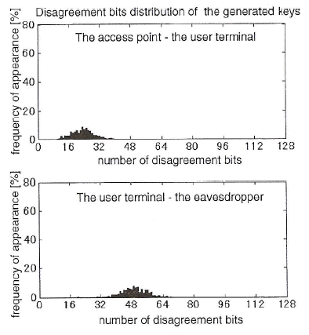
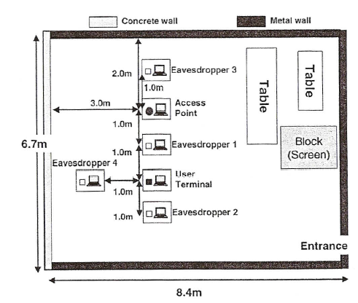
Security of such key sharing is based on an assumption that the space locations of the eavesdropper and legal users are different. This results in a much greater disagreements key bits between legal users and eavesdropper. Raw disagreement bit distribution taken from [7] is shown in Fig.3. Sketch of experimental room is presented in Fig.4.
Fig.4. Sketch of experimental room
Fig.3. Raw disagreement bit distribution

Slide 22
2.2. Our contribution. We present general theory based on some model in order to prove security of the key sharing system with the use of privacy amplification. We propose space diversity technique for increasing of security because our simulation of ESPAR-like system showed that the use of single omnidirectional antenna is not sufficiently for high security level. In order to present a disagreement in key bits of legal users we propose to use both “threshold-based” and “code-based” methods. It is interesting to note that there exist here two “seeming paradoxes”: - we do not need in a presence of noise at eavesdropper’s point to provide security, - large eavesdropper’s probability of bit error can be provided even so if mutual correlation between legal and illegal RSSI is rather significant.

Slide 23
2.3. Model of key sharing setting (without additive noise).
otherwise
otherwise
where
correlation matrices which are given
on index
Here are the key j-th bits of legal users and eavesdropper, respectively,
are quadrature components of j-th RSSI of legal users and eavesdropper, respectively
the attenuations on the i-th beam of legal user and eavesdropper, respectively,
the number of beams (pathes of wave propagations)
the radiation coefficients of the ESPAR-like system on the i-th beam in the j-th packet for legal user and eavesdropper, respectively.

Slide 24
Assumption: and model (1),(2) are public.
Particular case: (if an eavesdropper is located near the legal user)
Correlation coefficient (general case):
Particular case:
where
If , then we get by (4) that (nothing security)
If , then in general. In a particular case when
, then if
N.B. (“Paradox” 1)

Slide 25
More strong model (for KDP designer)
Eavesdropper is able to separate beams ; e.q. he (or she) has :
Then this means that for a particular case ( ) an eavesdropper is able to find
and hence to calculate the legal key bits exactly.
This is not the case generally if
Let us prove the key bit error probability for eavesdropper given the correlation
coefficient and variance
Then we have after simple transforms (see Appendix 1) :

Slide 26
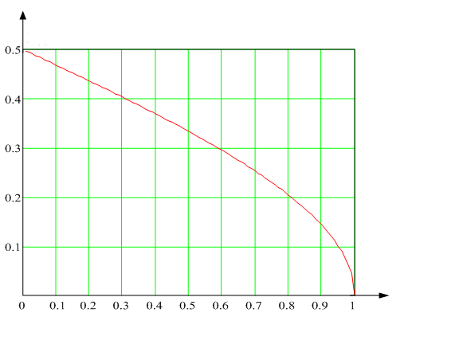
It follows from (5) :
(i) does not depend on but only on
(ii) If , then ; if , then (in line with our intuition)
The graph of versus is plotted in Fig.5.
We can conclude that it is sufficiently to provide
. (This is seeming “Paradox” 2).
See Section 3 for detail.
Fig.5. Dependence versus

Slide 27
2.4. Two beam model.
pathes 2
General model:
(we drop index “j” for notation simplicity )
Particular case:
E is located
very close to B.
ESPAR
A
(pathes 1)
E
B
Fig.6. Two beam model of KDP
New setting with a separation of beams by eavesdropper.
given

Slide 28
If E (as in Fig. 6 ) is between A and B, then
, that is reasonable.
Particular cases:
If r=1, then that is reasonable;
If r=0, then ;
If , then .
where

Slide 29
2.5. Simulation results of two beam model with ESPAR-like system:
1. Using a random exciting of ESPAR-like system* elements results in a random beam-forming antenna diagram.
(The number of radiation patterns can be provided as untractable by appropriated choice of the number ESPAR-like system elements “m” and the number of the bias voltage bits “ ”:
)
2. Radiation pattern amplitude can be approximated by Gaussion distribution with variable expectation and variance.
3. Radiation pattern amplitudes of ESRR with 6 radiators are uncorrelated for angle interval more than 1-4 degree.
The last point gives a chance to justify a general model in contrast to particular model (see slide 6).
* In our experiment we do not use ESPAR but electronically steerable ring radiator (ESRR) with 6 radiators equaly located on the circle of the radius 6 cm. We believe that ESRR gives more narrow beams than ESPAR

Slide 30
Let us consider two beam model (see slide (27))
If ESRR system generates signal , then using two beam wave propagation scheme we get:
where
- is the attenuation of the signal s(t) over the path 1 from A to B (see Fig.6)
- is the attenuation of the signal s(t) over the path 2 from A to B,
- is the attenuation of the signal s(t) over the path 1 from A to E,
- is the attenuation of the signal s(t) over the path 2 from A to E.
We let for simplicity that

Slide 31
Substituting (9) into (8) and using the relation (3), where the matrices
are determined by ESRR system simulation results(depending on the user’s location), we can calculate the correlation coefficients as a function of interval between locations of legal user B and eavesdropper E.
(The results are presented on Appendix 2 )
From these results we can do the following important conclusions:
1. Correlation coefficients are changing by periodical manner depending on
in the full interval (0, ) with the frequency propertional to (the radiated wave length).
2. It is can not be taken for granted that there exists some interval between legal user B and eavesdropper E outside of which correlation is less than some threshold, that could provide in turn a large probability of bit key error for E. (See slide 26). We can say only about a probability of such event.
These results somewhat contradict to a very optimistic conclusion presented in [7].

Slide 32
In order to find a way out from this situation we propose to use antenna diversity.
Then legal user B has m omnidirectional antennas which are randomly located in some area around of his presence. (The radius can be chosen of order , where is the length of radio wave used for communication)
The protocol of key sharing has to be slight changed:
The user B selects randomly one of m antennas and use it for a receiving and transmiting a series of packets.
We can claim that if the probability of a random event is that the key bit error probability for E is at least for each antenna , then the probability that after “m” consequtive chosen antennas we get in all cases the probability less than ,
is less than . (See Table 1.)

Slide 33
The probability (in percentages ) of the occurrence that for all points of eavesdropper presence at line between A and B
pathes 1, 2
h₁
2 Ant
1 Ant
3 Ant
(Path 1)
(Path 2)
B
A
E
d
d
h₂
Table 1.
l₁ =25 meters
d | Number of receiving antennas |  |  | Number of receiving antennas
 | 1 | 2 | 3 | 1 | 2 | 3
 | h₁=3m h₂=3m |  |  | h₁=4m h₂=2m
λ/2 | 7.8 / 3.4 | 6 / 2.5 | 4.2 / 1.7 | 9 / 4.7 | 8.9 / 4.7 | 7.8 / 4.1
λ |  | 4.9 / 2 | 2.4 / 1 |  | 8.5 / 4.5 | 8.5 / 4.5
2 λ |  | 3 / 0.9 | 1.5 / 0.5 |  | 8 / 4.4 | 8 / 4.4
4 λ |  | 1.4 / 0 | 0.5 / 0 |  | 6.3 / 2.4 | 6.3 / 2.4

Slide 34
2.6. Privacy Amplification Theorem for local binomical channel.
1
2
m
…
…
…
…
where is the total number of bits,
n – is the length of single substring,
m – is the number of substrings equal to the number of antennas,
If legal channel is noisy with the error bit probability , then in order to correct errors we have to send over noiseless channel check bits, where
. Then the inequality (10) has to be transformed to the following:

Slide 35
We can optimize the parameters n and N given and . The results of such optimization procedure are presented in Tables 2.
Parameters |  |  |  |  | Results
 | I₀ | P_{m} | P₀ | m | n | N | R_{k}
256 | 10⁻⁹ | 0 | 0,05 | 3 | 1989 | 5967 | 0,043
 |  |  |  | 5 |  | 9945 | 0,026
 |  |  |  | 10 |  | 19890 | 0,013
128 | 10⁻⁹ |  | 0,05 | 3 | 1101 | 3303 | 0,039
 |  |  |  | 5 |  | 5505 | 0,023
 |  |  |  | 10 |  | 11010 | 0,012
256 | 10⁻⁶ |  | 0,05 | 3 | 1920 | 5760 | 0,044
 |  |  |  | 5 |  | 9600 | 0,027
 |  |  |  | 10 |  | 19200 | 0,013
256 | 10⁻⁹ |  | 0,1 | 3 | 1001 | 3003 | 0,085
 |  |  |  | 5 |  | 5005 | 0,051
 |  |  |  | 10 |  | 10010 | 0,026
256 | 10⁻⁹ |  | 0,2 | 3 | 515 | 1545 | 0,166
 |  |  |  | 5 |  | 2525 | 0,101
 |  |  |  | 10 |  | 5150 | 0,050
128 | 10⁻⁹ |  | 0,1 | 3 | 554 | 1662 | 0,077
 |  |  |  | 5 |  | 2770 | 0,046
 |  |  |  | 10 |  | 5540 | 0,023
Table 2. Results of parameter optimization

Slide 36
For noisy legal channel with bit error probability the results of parameter optimization are presented in Table 3.
Parameters |  |  |  |  | Results
 | I₀ | P_{m} | P₀ | m | n | N | R_{k}
256 | 10⁻⁹ | 10⁻² | 0,05 | 3 | 3978 | 11934 | 0,021
 |  |  |  | 5 | 11930 | 59650 | 0,004
 |  |  |  | 10
128 | 10⁻⁹ |  | 0,05 | 3 | 2201 | 6603 | 0,019
 |  |  |  | 5 | 6599 | 32995 | 0,004
 |  |  |  | 10
256 | 10⁻⁶ |  | 0,05 | 3 | 3840 | 11520 | 0,022
 |  |  |  | 5 | 11514 | 57570 | 0,004
 |  |  |  | 10
256 | 10⁻⁹ |  | 0,1 | 3 | 1337 | 4011 | 0,064
 |  |  |  | 5 | 1722 | 8610 | 0,030
 |  |  |  | 10 | 6186 | 61860 | 0,004
256 | 10⁻⁹ |  | 0,2 | 3 | 592 | 1776 | 0,144
 |  |  |  | 5 | 657 | 3285 | 0,078
 |  |  |  | 10 | 906 | 9060 | 0,028
128 | 10⁻⁹ |  | 0,1 | 3 | 740 | 2220 | 0,058
 |  |  |  | 5 | 953 | 4765 | 0,027
 |  |  |  | 10 | 3422 | 34220 | 0,004
Table 3. Results of parameter optimization for noisy channel.

Slide 37
We can see from these tables that the desired security and reliability can be achieved for different conditions but as the cost of very long raw string and small key rate.
Remark. In the noisy legal channel it is possible to increase reliability using an erasuring procedure of those key bits , which have the corresponding values
below some threshold. The numbers of erasured key bits can be later agree on public channel.

Slide 38
2.7. Conclusion and future work.
1. We presented a formal model for key sharing based on the use of ESPAR-like system in multipath channels.
2. It was established a connection between correlation of continuous Gaussian processes and bit error probability for eavesdropper.
3. Correlation coefficients have been found by ESRR system simulation for two-beam channel model and it was shown that key bit disagreement between legal users and eavesdropper cannot be taken for granted even on long enough distance between their location.
4. We proposed to use antenna (space) diversity in order to enhance security of key sharing and perform parameter optimization of privacy amplification procedure.
5. We are going in the future to extend our investigations for multi-beam channel model.
6. We would like to arrange (may be with colleagues in other countries) real experiment with radio multipath channel in order to specify our theoretical results.
7. Further investigations of our model in noisy legal channel with the use both analog and coding method are also expected.

Slide 39
References.
1.A. Wyner, “Wire-tap channel concept,” Bell System Technical Journal, vol. 54, pp. 1355–1387, 1975.
2.Wyner A., Ozarov L. Wire-tap Channel II// AT&T Bell Lab. Tech.J. 1984.v.63.No10, p.2135-2157.
3.U. Maurer, “Secret key agreement by public discussion from common information.” IEEE Transactions on Information Theory, vol. 39, no. 3, pp. 733–742, 1993.
4.U. Maurer, “Information-theoretically secure secret-key agreement by not authenticated public discussion,” Lecture Notes in Computer Science, vol. 1233, pp. 209–223, 1997.
5.V. Yakovlev, V. Korzhik, G. Morales-Luna. Key Distribution Protocols Based on Noisy Channels in Presence of Active Adversary. IEEE on IT, vol.54, No.6,2008,pp.-2535-2549
6.C. H. Bennett and g. Brassard, “Quantum cryptography: Public key distribution and coin tossing,” in Proceedings of International Conference on Computers, Systems and Signal Processing, December 1984.
7.T. Aono, K. Higuchi, T. Ohira, B. Komiyama, and H. Sasaoka, “Wireless secret key generation exploiting reactance-domain scalar response of multipath fading channels,” IEEE Transactions on Antennas and Propagation, vol. 53, no. 11, pp. 3776–3784, 2005.
8. A. Kitaura and H. Sasaoka, “A scheme of private key agreement based on the channel characteristics in OFDM land mobile radio.” Electronics and Communications in Japan (Part III: Fundamental Electronic Science), vol. 88, no. 9, pp. 1–10, 2005.

Slide 40
9.C. H. Bennett, G. Brassard, C. Crepeau, and U. M. Maurer, “Generalized privacy amplification,” IEEE Transactions on Information Theory, vol. 41, no. 6, pp. 1915–1923, 1995.
10.V. Yakovlev, V. Korzhik, G. Morales-Luna. Non-asymptotic Performance Evaluation of Key Distribution Protocols Based on Noisy Channels in Presence of Active Adversary. In Proc. X. Spanish Meeting on Cryptology and Information Security, Salamanca 2008, p. 63-68.
11.V. Korjik, G. Morales-Luna, and V. Balakirsky, “Privacy amplification theorem for noisy main channel,” Lecture Notes in Computer Science, vol. 2200, pp. 18–26, 2001.
12.V.Korzhik,D.Kushnir,”Key sharing based on the wire-tap channeltype IIconcept with noisy main channel”, In Proc.Asiacrypt’96,
13.V. Korjik, V. Yakovlev, R. Chesnokov, G. Morales-Luna, Performance Evaluation of Keyless Authentication Based on Noisy Channel. International Conference of “Mathematical Metods, Models and Architectures for Computer Network Security”, Springer New Serias, 2007. N. 1. p.151-161
14.I.Gradshtejn, I.Ryzik ,”Tables of integrals, sums, series and products”,FM Publisher,,Moscow,1963,(in Russian).

Slide 41
Appendix 1. Proof of the relation (5)
 | (1.1)
Consider the second integral:
Let us denote:
(1.2)
Then using eq. 3.222 [14], we can write
(1.3)

Slide 42
Substituting (1.2) into (1.3), we get
(1.4)
Let us use (1.4) in (1.1)
(1.5)
Apply to integral above eq. (8.285) from [14].Then changing variables :
(1.6)

Slide 43
we get :
(1.7)
With the notation , we obtain
(1.8)
Finally using eq. (8.285) from [14] we have
(1.9)
If r=1, then arctg(0)=0, P(1)=0 – no error;
if r=0, then arctg(∞)= ,
P(1)=
The full error probability is
For reason of symmetry Р'=2Р(1), we get
(1.10)

Slide 44
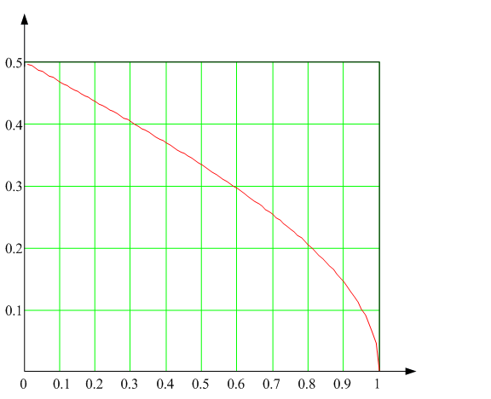
Fig.1. 1. The probability versus r

Slide 45
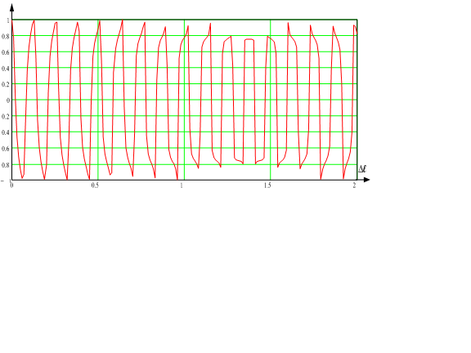
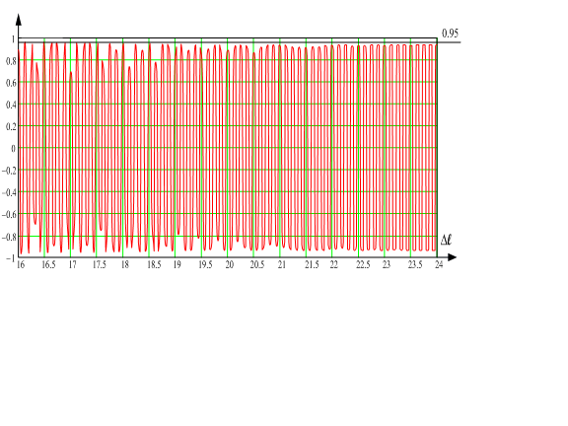
Appendix 2. Dependence versus E-B distance
Remark. Distance between legal users A and B is equal to 25 m.
a) The model with reflection from ceiling
b) The model with reflection from walls

